Slide 1
Final project
Mohab Mohamed , 221002016
Yousef Abdallah , 221002152
Eng Hady Yaser

Slide 2
To compare the performance of two deep learning architectures U-Net and EfficientNet-based segmentation for semantic segmentation tasks using the CamVid dataset, a benchmark for road scene understanding.

Slide 3
📂 Dataset: CamVid:
The CamVid dataset provides images and pixel-level annotated labels for road scenes.
Contains:
train/: Input RGB images.
trainannot/: Corresponding segmentation masks.
Each pixel in the mask image represents a semantic class (e.g., building, car, pedestrian, road, etc.).
We focused on 12 semantic classes for classification.

Slide 4
🧹 Preprocessing Steps:
Resizing all images and masks to 128×128 resolution.
Normalizing image pixel values to range [0, 1].
One-hot encoding the segmentation masks to support multi-class classification.
Splitting the data into:
Training Set: 80%
Testing Set: 20%

Slide 5
🔸 1. U-Net:
A classical encoder-decoder architecture originally designed for biomedical image segmentation.
Characteristics:
Downsampling using convolution + max-pooling.
Upsampling using transposed convolutions.
Skip connections to retain spatial features.
🔸 2. EfficientNet-Based Segmentation:
Combines EfficientNetB0 as the encoder (pretrained on ImageNet).
Builds a custom decoder using:
Transposed convolutions.
Feature concatenation from skip connections.
Aims to leverage EfficientNet's parameter efficiency and high accuracy.

Slide 6
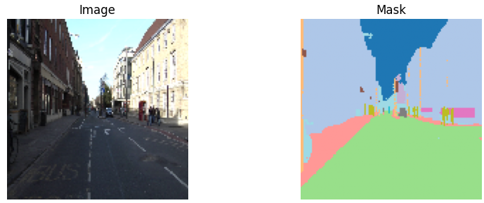

Slide 7
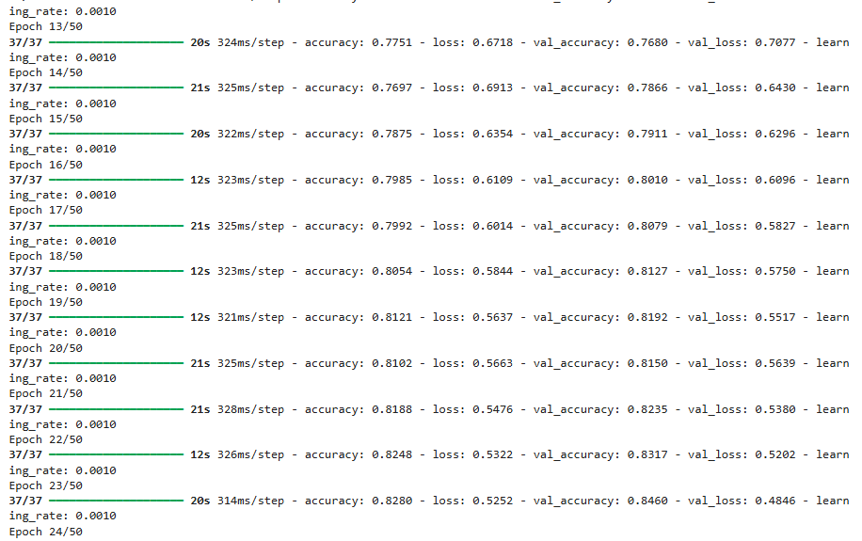

Slide 8
